Slide 1
Modern Cryptography
Viktorija Almazova
Cloud Security Architect

Slide 2
Where do we have crypto?

Slide 3
Cryptology
Cryptography
Cryptanalysis
Symmetric Algorithms
Asymmetric Algorithms
Protocols
Block Ciphers
Stream Ciphers
Classification of the Field of Cryptology

Slide 4
Some basic facts..
Ancient Crypto: Early signs of encryption in Egypt in ca. 2000 B.C. Letter-based encryption schemes (e.g., Caesar cipher) popular ever since.
Symmetric algorithms: All encryption schemes from ancient times until 1976 were symmetric ones.
Asymmetric algorithms: In 1976 public-key (or asymmetric) cryptography was openly proposed by Diffie, Hellman and Merkle.
Hybrid Schemes: The majority of today‘s protocols are hybrid schemes, i.e., the use both
symmetric ciphers (e.g., for encryption and message authentication) and
asymmetric ciphers (e.g., for key exchange and digital signature).

Slide 5
Symmetric Cryptography

Slide 6
Symmetric Cryptography
Alternative names: private-key, single-key or secret-key cryptography
Encryption (e)
Decryption (d)
k
Key Generator
k

Slide 7
Cryptanalysis..
There is no mathematical proof of security for any practical cipher
The only way to have assurance that a cipher is secure is to try to break it (and fail)!
Kerckhoff‘s Principle (1883) is paramount in modern cryptography:
In order to achieve Kerckhoff‘s Principle in practice: Only use widely known ciphers that have been cryptanalyzed for several years by good cryptographers!
A cryptosystem should be secure even if the attacker knows all details about the system, with the exception of the secret key.

Slide 8
Cryptanalysis
Classical Cryptanalysis
Implementation attacks
Social Engineering
Mathematical Analysis
Brute-force Analysis
Classification of the Field of Cryptanalysis

Slide 9
Cryptology
Cryptography
Cryptanalysis
Symmetric Algorithms
Asymmetric Algorithms
Protocols
RSA
ECDSA
Digital signatures
RSA, ElGamal
Hash Functions
MD5, SHA-1,
Message Authentication Codes (MACs)
HMAC
Key Establishment
Diffie-Hellman key exchange
Block Ciphers
Stream Ciphers
DES/3DES
Blowfish
Twofish
AES
RC4
A5/2
Trivium
ChaCha20

Slide 10
SSL/TLS..
What is SSL?
Secured Sockets Layer (SSL) is an older version of Transport Layer Security (TLS).
SSL and TLS are often used to refer to the same thing, but you have to know that SSL is since 2014 considered as non-secure.
All commonly used browsers support now both protocols.
What is TLS?
A key point is to remember that TLS is a secure communication protocol point-to-point.
Typical use of TLS encryption
Web
Email
SFTP

Slide 11
Certificates
Using a SSL / TLS link between a web browser and a web server, the web browser requires that the server identifies itself using an SSL / TLS certificate.
The browser uses this certificate to verify if it is valid and to trust the web site. The web browser will trust the web server if the certificate of the web site is valid:
The certificate is issued for the website to which the browser is connecting to
The certificate is not expired
The certificate is not revoked
The certificate is signed by a trusted third-party acting as certification agent (CA)
If the certificate is valid, the web browser is ready to start an encrypted connection with the web server; else the web browser warns the visitor that the website is not trusted.

Slide 12
Certificate

Slide 13
Chain of Trust
https://letsencrypt.org/certificates/

Slide 14
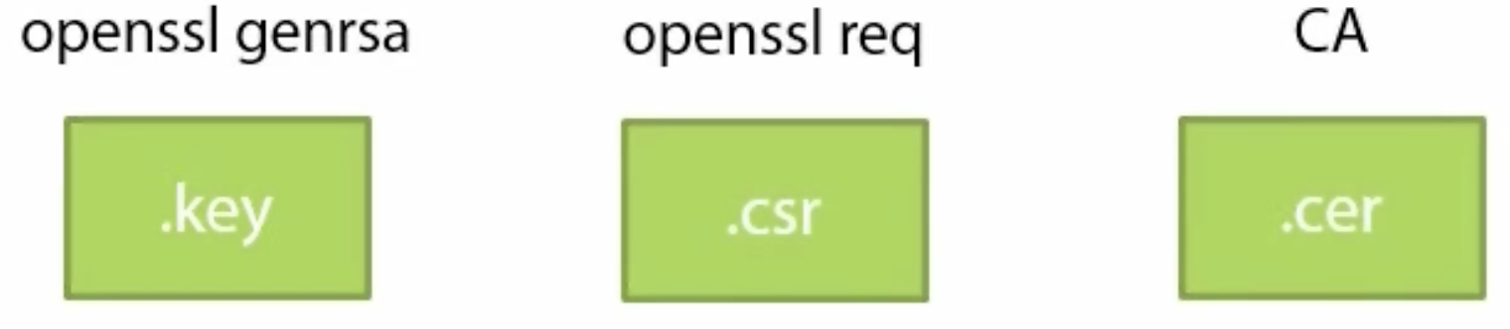
Public Key Cryptography Standards
PKCS #7
Cryptographic Message Syntax
Certificates
PKCS #10
Certification Request
PKCS #12
Personal Information Exchange Syntax
Private Keys
Common file formats

Slide 15
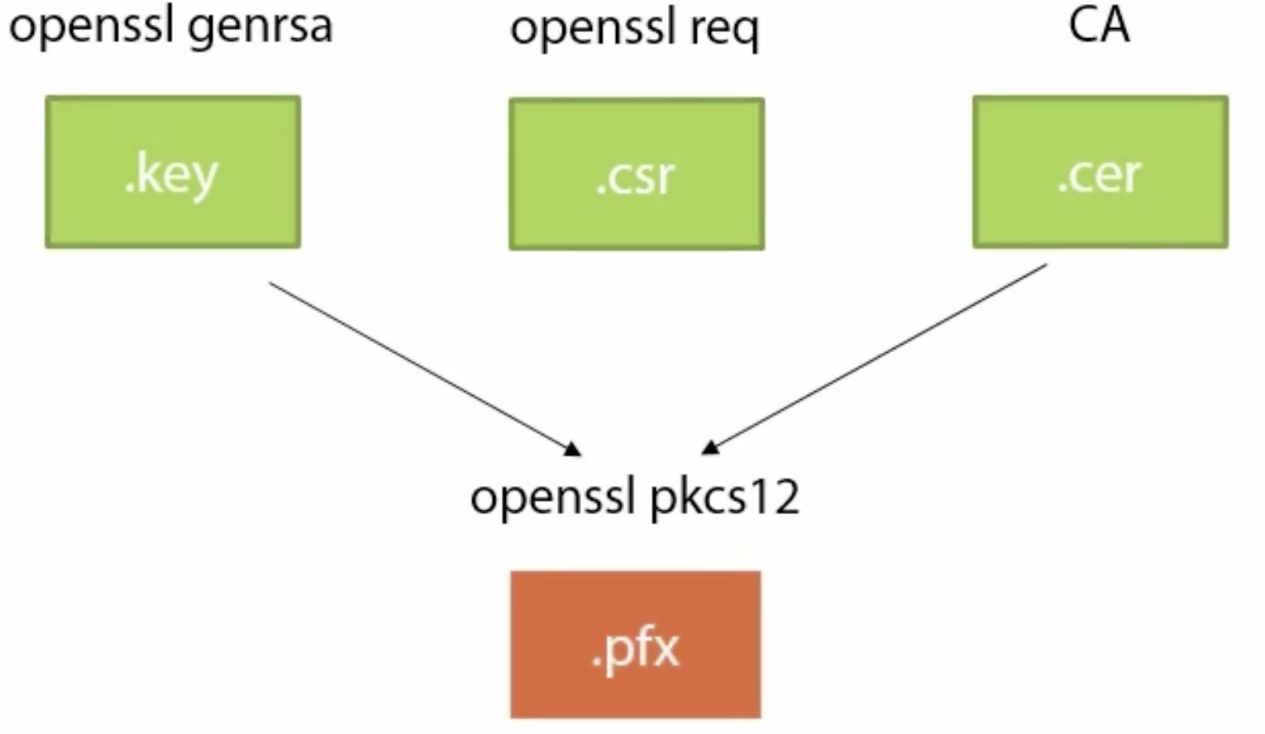
Public Key Cryptography Standards
PKCS #7
Cryptographic Message Syntax
Certificates
PKCS #10
Certification Request
PKCS #12
Personal Information Exchange Syntax
Private Keys
Common file formats
PEM (Privacy Enhanced Mail)

Slide 16
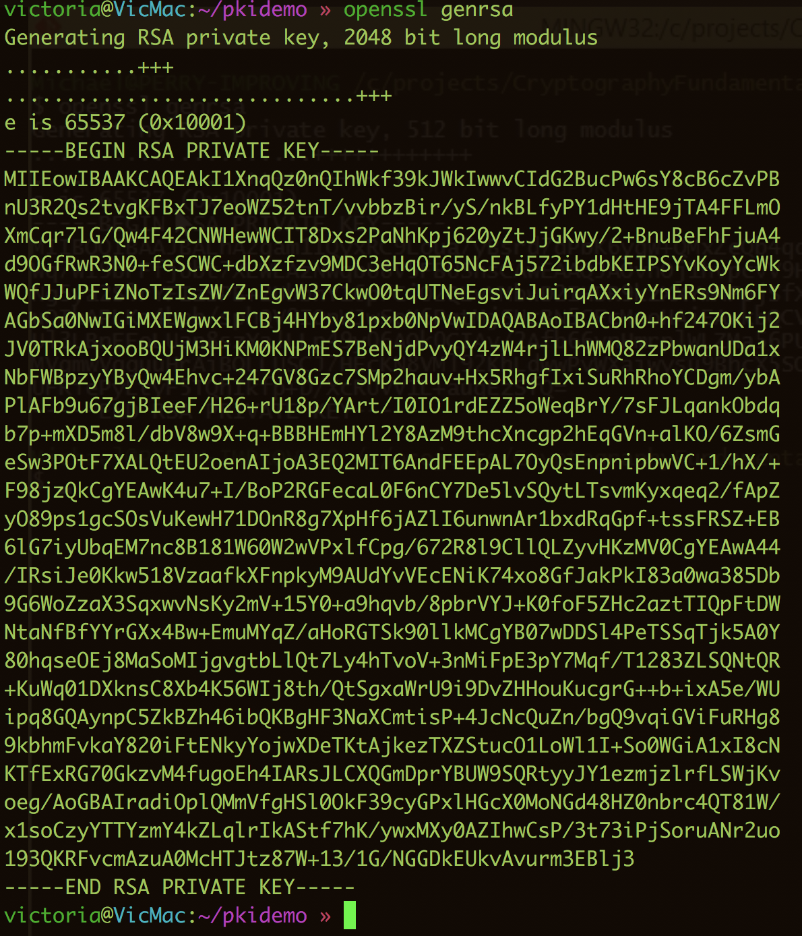
Openssl RSA demo

Slide 17
Secure connection using the SSL/TLS certificate

Slide 18
Cryptology
Cryptography
Cryptanalysis
Symmetric Algorithms
Asymmetric Algorithms
Protocols
RSA
ECDSA
Digital signatures
RSA, ElGamal
Hash Functions
MD5, SHA-1, SHA2
Message Authentication Codes (MACs)
HMAC
Key Establishment
Diffie-Hellman key exchange
Block Ciphers
Stream Ciphers
DES/3DES
Blowfish
Twofish
AES
RC4
A5/2
Trivium
ChaCha20

Slide 19
HTTPS
[SSL/TLS]_[key exchange]_[authentication_key]_WITH_[block cipher]_[authentication hash]
TLS_ECDHE_ECDSA_WITH_AES_128_GCM_SHA256

Slide 20
Protocols
There are five protocols in the SSL/TLS family: SSL v2, SSL v3, TLS v1.0, TLS v1.1, and TLS v1.2:
SSL v2 is insecure and must not be used. This protocol version is so bad that it can be used to attack RSA keys and sites with the same name even if they are on an entirely different servers (the DROWN attack).
SSL v3 is insecure when used with HTTP (the POODLE attack) and weak when used with other protocols. It’s also obsolete and shouldn’t be used.
TLS v1.0 is also a legacy protocol that shouldn't be used, but it's typically still necessary in practice. Its major weakness (BEAST) has been mitigated in modern browsers, but other problems remain.
TLS v1.1 and v1.2 are both without known security issues, but only v1.2 provides modern cryptographic algorithms.
TLS v1.2 should be your main protocol because it's the only version that offers modern authenticated encryption (also known as AEAD). If you don't support TLS v1.2 today, your security is lacking.

Slide 21
Key exchange
For the key exchange typically choice is between the classic ephemeral Diffie-Hellman key exchange (DHE) and its elliptic curve variant, ECDHE.
There are other key exchange algorithms, but they're generally insecure in one way or another. The RSA key exchange is still very popular, but it doesn't provide forward secrecy.
Use Forward Secrecy (perfect forward secrecy) - is a protocol feature that enables secure conversations that are not dependent on the server’s private key. To enable PFS, the client and the server have to be capable of using a cipher suite that utilises the Diffie-Hellman key exchange. Importantly, the key exchange has to be ephemeral. This means that the client and the server will generate a new set of Diffie-Hellman parameters for each session. These parameters can never be re-used and should never be stored, the ephemeral part, and that's what offers the protection going forwards.

Slide 22
Key exchange – best practice
Use only suites that use ECDHE and DHE (also referred to as EECDH and EDH) for the key exchange
The EC variant is faster
Both offer Perfect Forward Secrecy (PFS)
TLSv1.3 will only support PFS capable key exchange
TLS_ECDHE_RSA_WITH_AES_128_GCM_SHA256
TLS_ECDHE_RSA_WITH_AES_256_GCM_SHA384
TLS_DHE_RSA_WITH_AES_128_GCM_SHA256
TLS_DHE_RSA_WITH_AES_256_GCM_SHA384

Slide 23
Authentication key algorithm
Mostly RSA is used as widely supported
But ECDSA is considerably faster
Can be served both RSA and ECDSA certificates for the best of both worlds
With RSA certificate:
TLS_ECDHE_RSA_WITH_AES_128_GCM_SHA256
TLS_ECDHE_RSA_WITH_AES_256_GCM_SHA384
With ECDSA certificate:
TLS_ECDHE_ECDSA_WITH_AES_128_GCM_SHA256
TLS_ECDHE_ECDSA_WITH_AES_256_GCM_SHA384
With hybrid RSA and ECDSA certificate:
TLS_ECDHE_ECDSA_WITH_AES_128_GCM_SHA256
TLS_ECDHE_ECDSA_WITH_AES_256_GCM_SHA384
TLS_ECDHE_RSA_WITH_AES_128_GCM_SHA256
TLS_ECDHE_RSA_WITH_AES_256_GCM_SHA384

Slide 24
Block cipher
AES is the preferred algorithm and using a key size of 128bits is acceptable
The GCM segment is the mode of the cipher
GCM suites should be prioritised over non GCM suites (CBC). An example with the GCM and non-GCM versions of the same suite
TLSv1.3 will only support AEAD suites
TLS_ECDHE_RSA_WITH_AES_128_GCM_SHA256
TLS_ECDHE_RSA_WITH_AES_256_GCM_SHA384
TLS_ECDHE_RSA_WITH_AES_256_CBC_SHA
TLS_DHE_RSA_WITH_AES_256_CBC_SHA

Slide 25
Authentication hash
SHA-256 is now the industry-standard signature hash algorithm for SSL certificates
SHA-256 provides stronger security and has replaced SHA-1 as the recommended algorithm
SHA-256 is supported by all current browsers
There are currently 6 different SHA2 variants including:
SHA-224
SHA-256
SHA-384
SHA-512
SHA-512/224
SHA-512/256

Slide 26
Putting together.. best practices
TLS_ECDHE_ECDSA_WITH_AES_128_GCM_SHA256
TLS_ECDHE_ECDSA_WITH_AES_256_GCM_SHA384
TLS_ECDHE_ECDSA_WITH_AES_128_CBC_SHA
TLS_ECDHE_ECDSA_WITH_AES_256_CBC_SHA
TLS_ECDHE_ECDSA_WITH_AES_128_CBC_SHA256
TLS_ECDHE_ECDSA_WITH_AES_256_CBC_SHA384
TLS_ECDHE_RSA_WITH_AES_128_GCM_SHA256
TLS_ECDHE_RSA_WITH_AES_256_GCM_SHA384
TLS_ECDHE_RSA_WITH_AES_128_CBC_SHA
TLS_ECDHE_RSA_WITH_AES_256_CBC_SHA
TLS_ECDHE_RSA_WITH_AES_128_CBC_SHA256
TLS_ECDHE_RSA_WITH_AES_256_CBC_SHA384
TLS_DHE_RSA_WITH_AES_128_GCM_SHA256
TLS_DHE_RSA_WITH_AES_256_GCM_SHA384
TLS_DHE_RSA_WITH_AES_128_CBC_SHA
TLS_DHE_RSA_WITH_AES_256_CBC_SHA
TLS_DHE_RSA_WITH_AES_128_CBC_SHA256
TLS_DHE_RSA_WITH_AES_256_CBC_SHA256

Slide 27
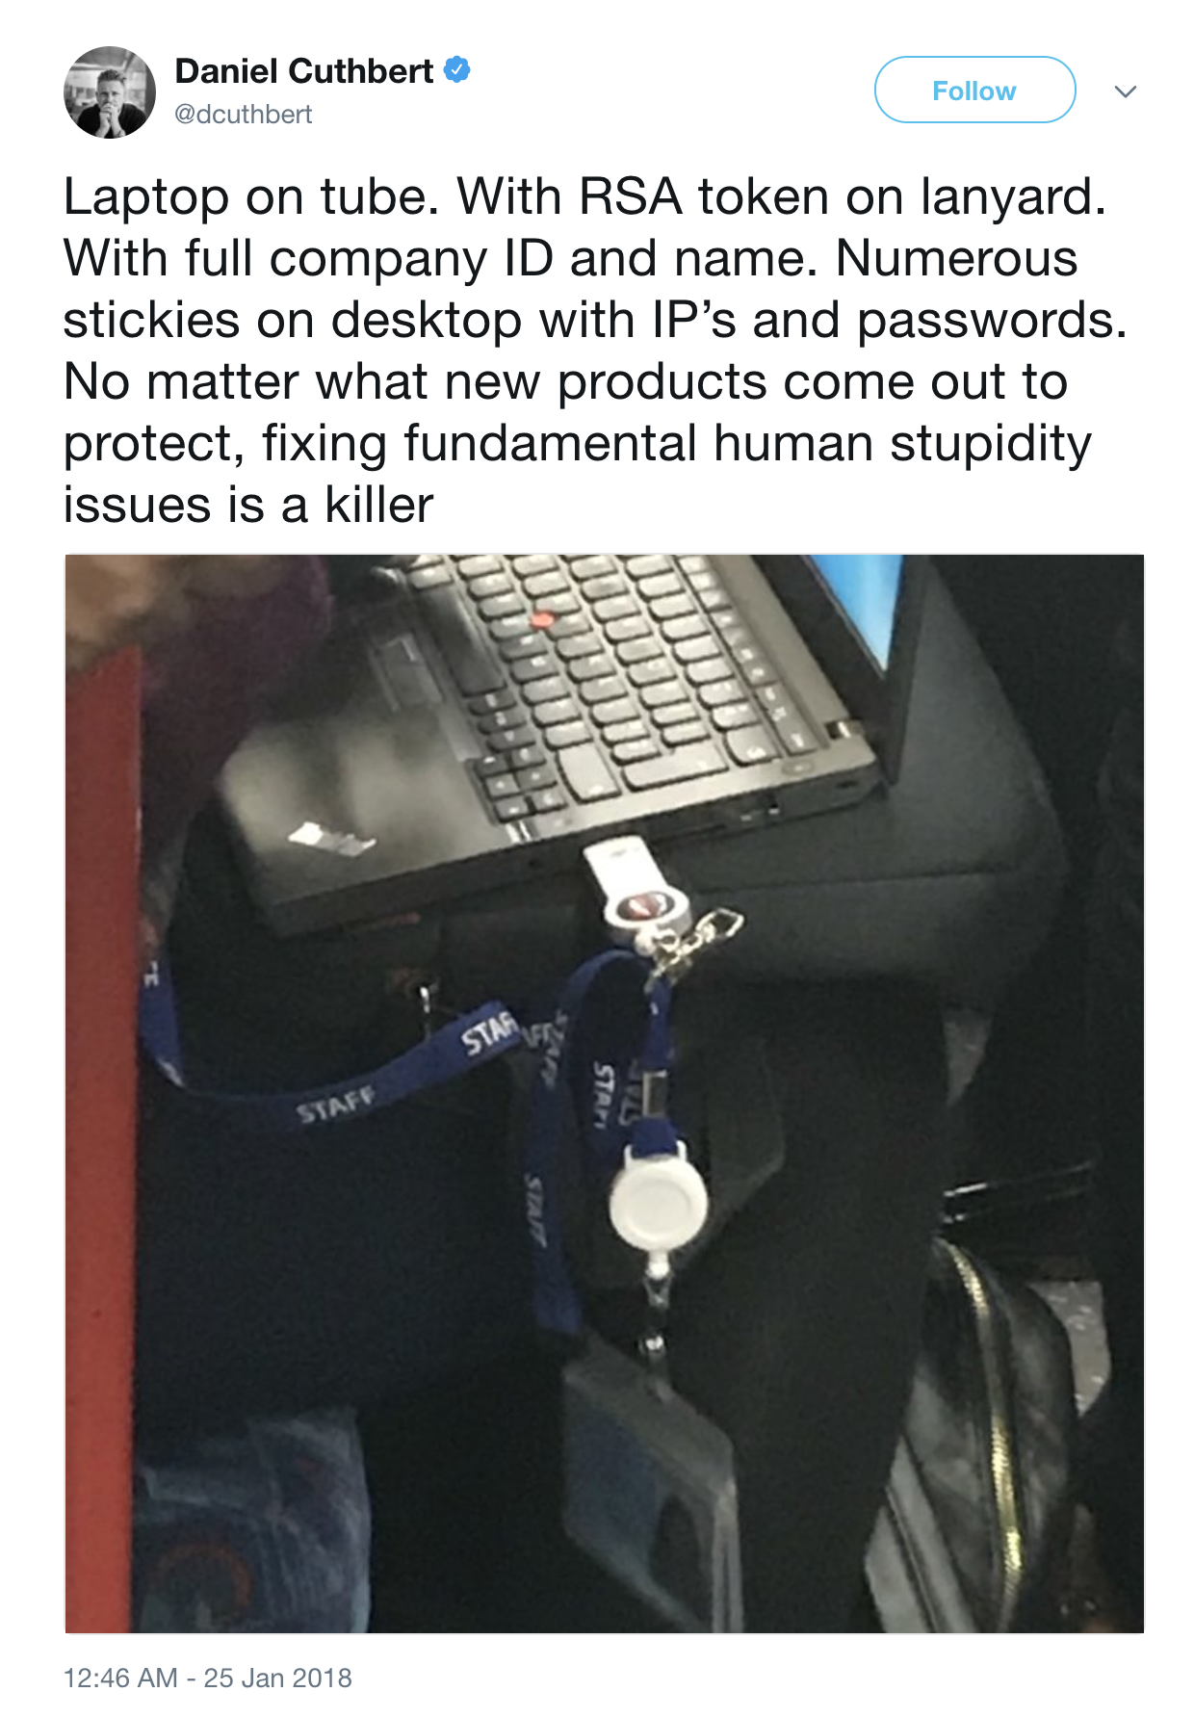
And at the end of a day..
https://github.com/ssllabs/research/wiki/SSL-and-TLS-Deployment-Best-Practices
https://scotthelme.co.uk/
https://securityheaders.io/
https://www.youtube.com/channel/UC1usFRN4LCMcfIV7UjHNuQg?pbjreload=10

